Slide 1
SFCS
SmartFan Control System
ECEN 5613 - EMBEDDED SYSTEM DESIGN
ISHA SHARMA

Slide 2
DESCRIPTION
SFCS, ISHA SHARMA, 12-03-2023
2
The Smart Fan Control System is an intelligent and user-friendly solution for controlling the speed of a DC motor-based fan. The system is designed to be simple to use and intuitive, allowing the user to adjust the fan speed with a single control knob.
It is based on the powerful STM32F411 microcontroller and features an OLED display, an ADC input, a potentiometer, an indicator LED, and a DC motor driver IC (L293D). Its advanced features, such as the OLED display and indicator LED, make it an ideal choice for various applications, including home automation, industrial control, and environmental monitoring.

Slide 3
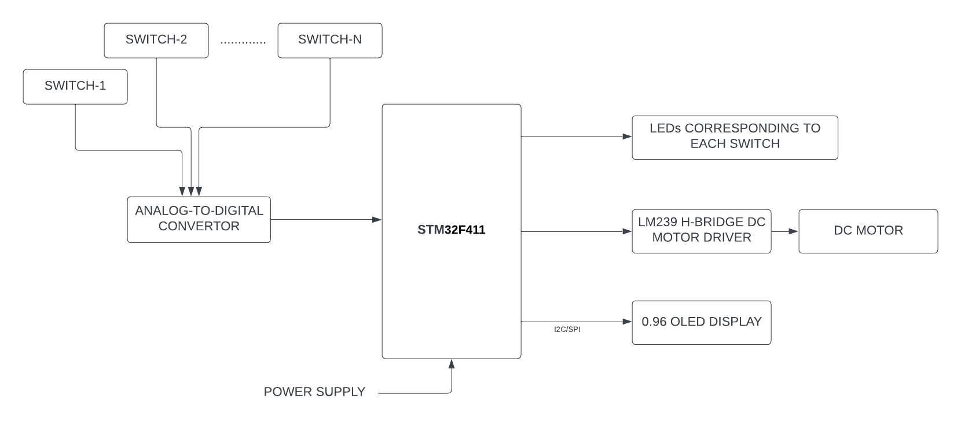
BLOCK DIAGRAM
SFCS, ISHA SHARMA, 12-03-2023
3

Slide 4
SFCS, ISHA SHARMA, 12-03-2023
4
PROMISED | DELIVERED
Multiple switches for speed control | Potentiometer was used instead
Multiple LEDs for speed indication | One LED indicating ON/oFF state
PCB board interfacing all sensors/actuators as a module | Breadboard version was implemented instead
DC motor representing a FAN | DC motor failed
Bare metal coding for all interfaces | ADC,OLED interfaced via HAL

Slide 5
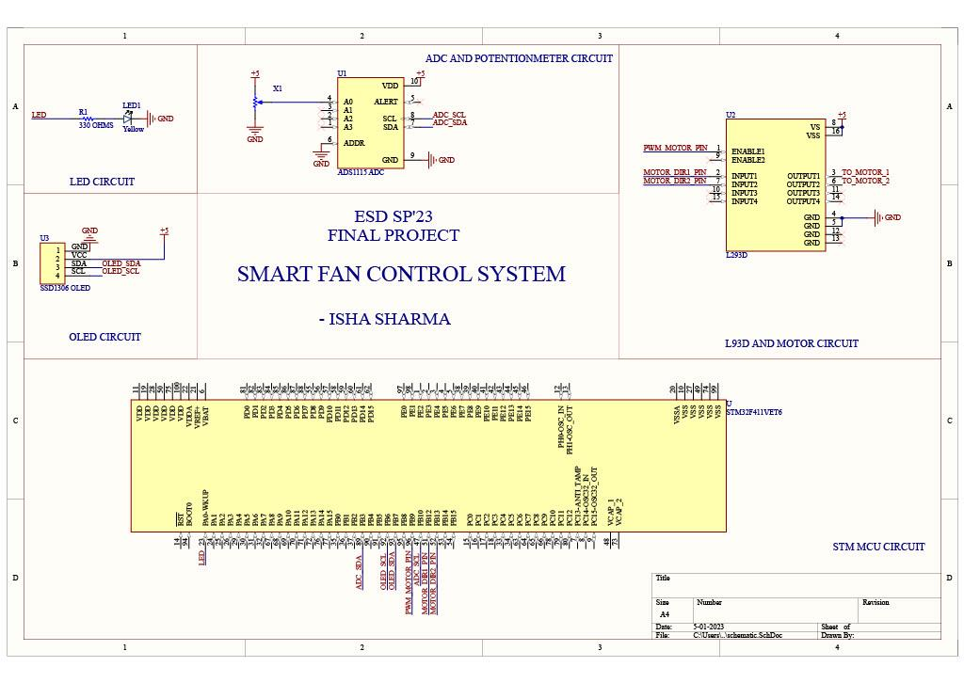
SFCS, ISHA SHARMA, 12-03-2023
5

Slide 6
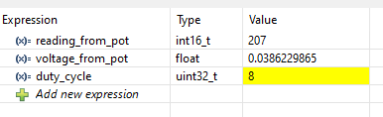
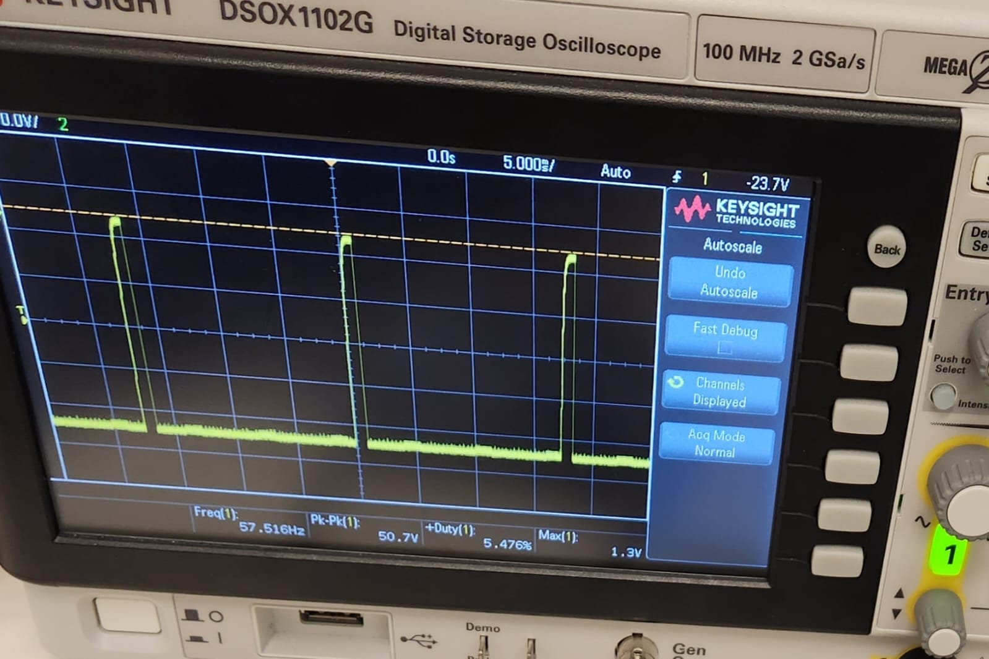
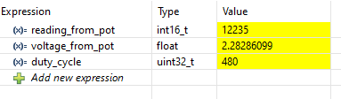
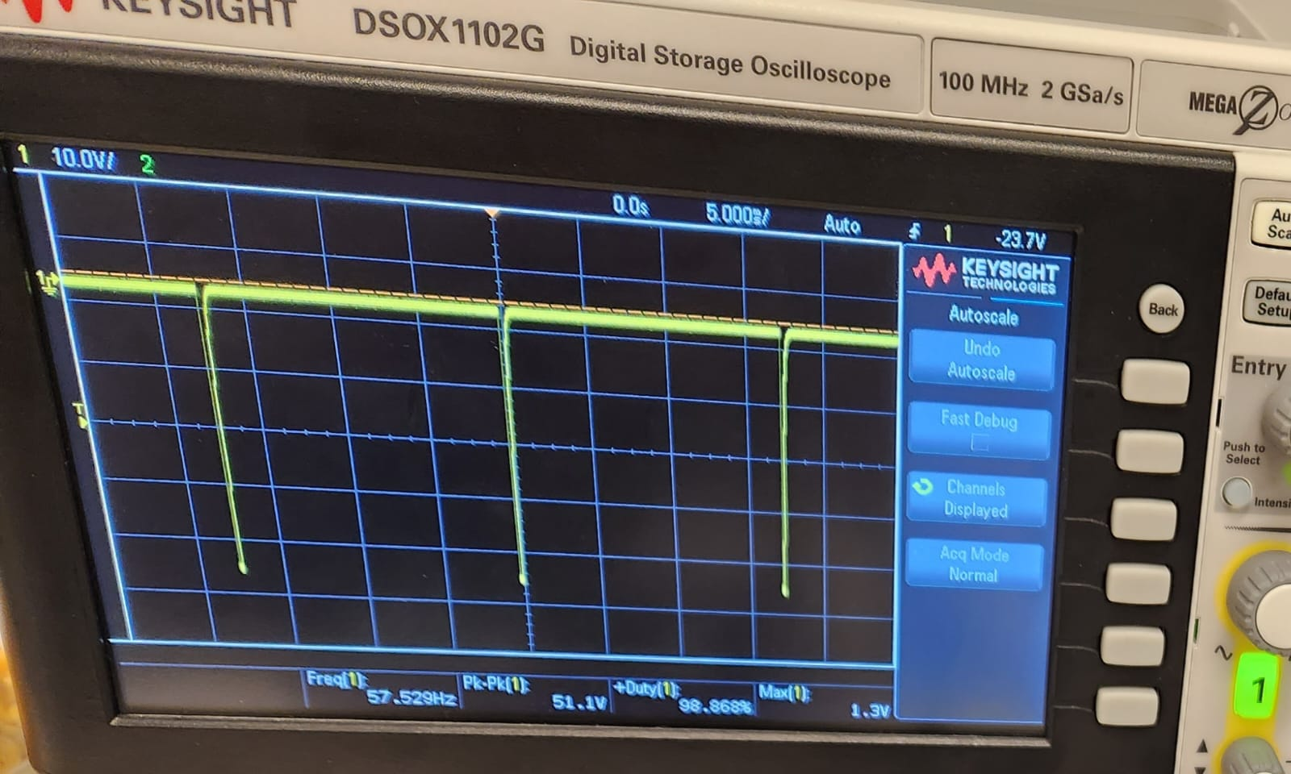
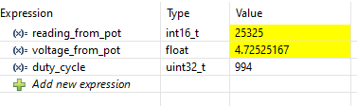
OUTPUTS
SFCS, ISHA SHARMA, 12-03-2023
6

Slide 7
THANK YOU!

